Slide 1
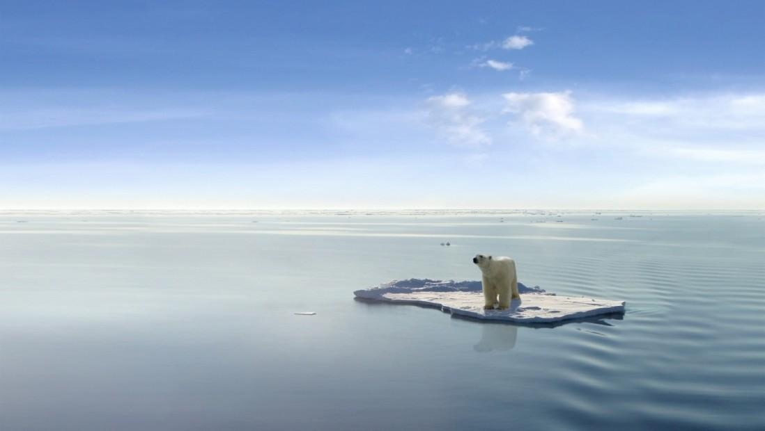
Group 8: Anna, Dianne, Helin, Tejas
Climate Change : World and Canada View

Slide 2
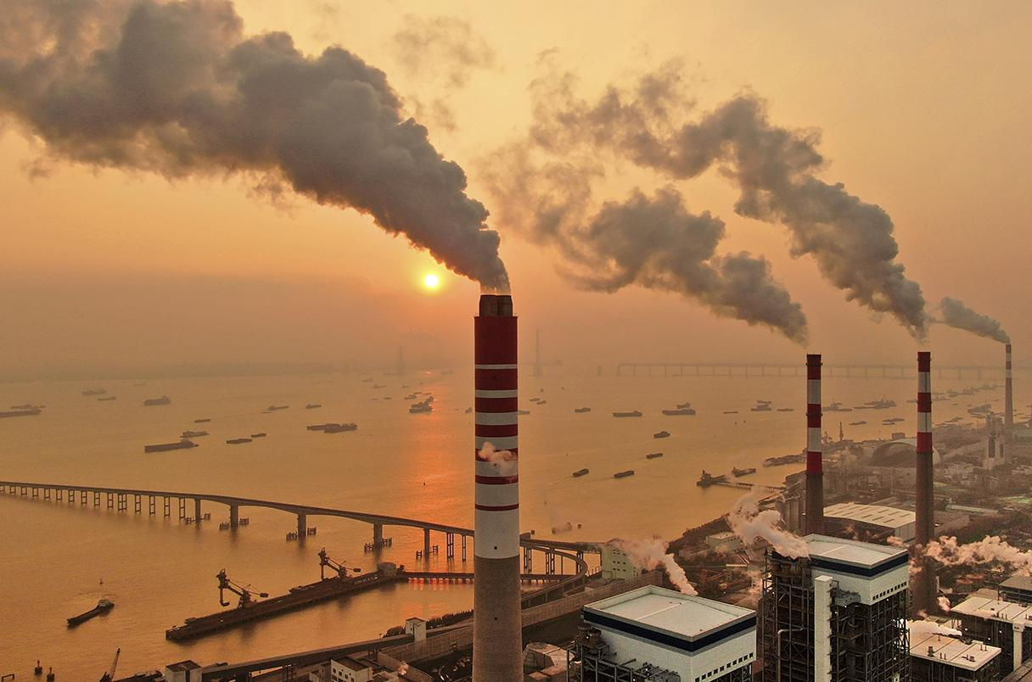
Summary
Climate change impacts us all. Industries are now including Sustainability as a core value of their visions and using data analytics to drive meaningful decision making towards a greener future
This project provides an example of how machine learning can be used as a tool to predict future warming trends and the impact of them on our world

Slide 3
Objectives-Processes
Data Preparation: Importing and preprocessing datasets
Exploratory Data Analysis: Visualizing the data and identifying any patterns or trends
Model Training and Testing: Splitting the data and training models using linear and polynomial regression
Future Temperature Prediction: Using the trained models to make predictions on future temperature changes
Visualization: Plotting the temperature data and predictions and compare the model’s performance

Slide 4
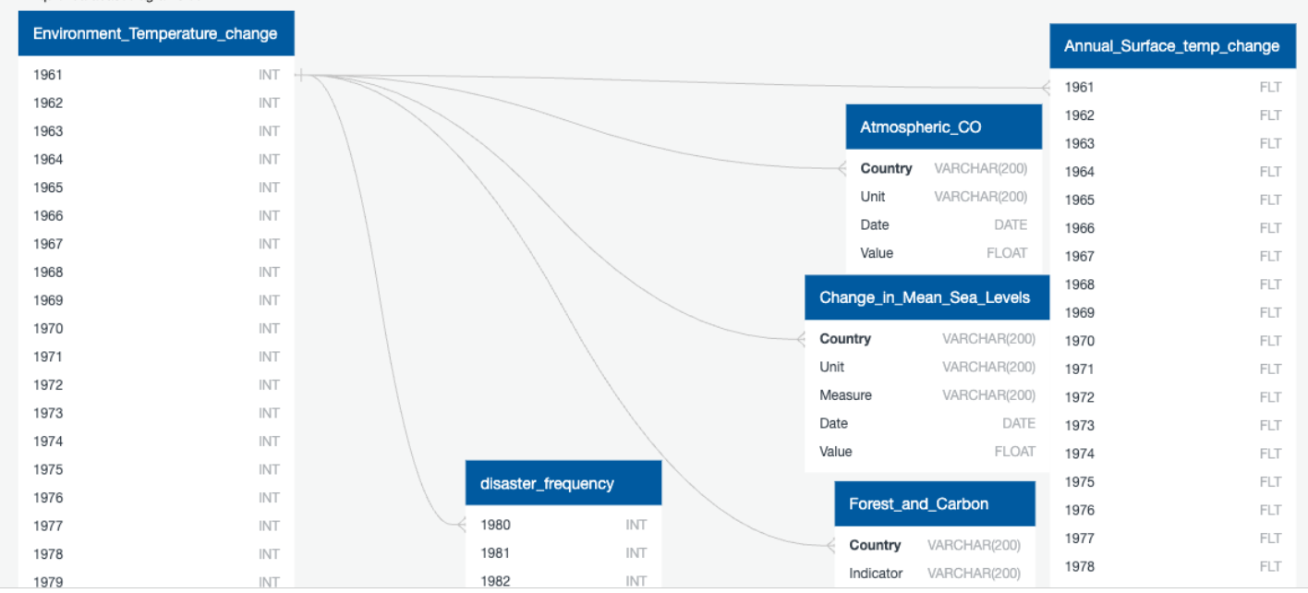
DATASET
Sources : Kaggle ,Nasa, Worldbank, Emdat
Sources : Kaggle ,Nasa, Worldbank,

Slide 5
DATASET
Applications & Libraries
Python
Pandas
Plotly
SQL
Tableau
Sci.kit Learn
Spark
Leaflet

Slide 6
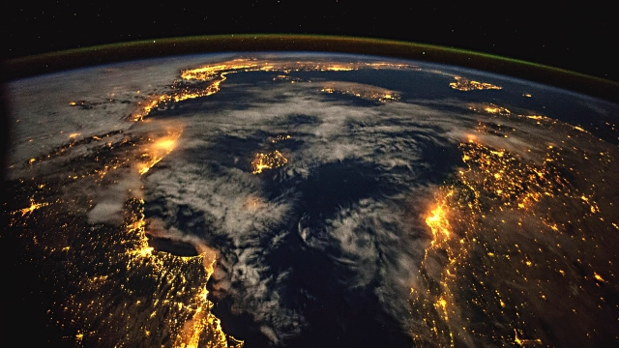
Global View -Helin

Slide 7
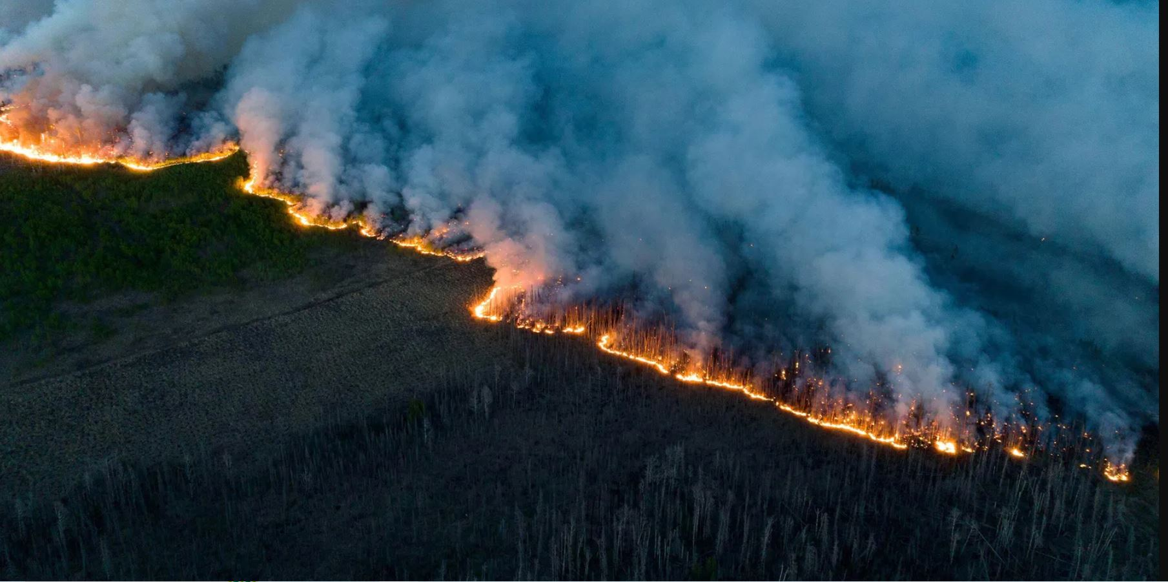
Impact in Canada - Anna

Slide 8
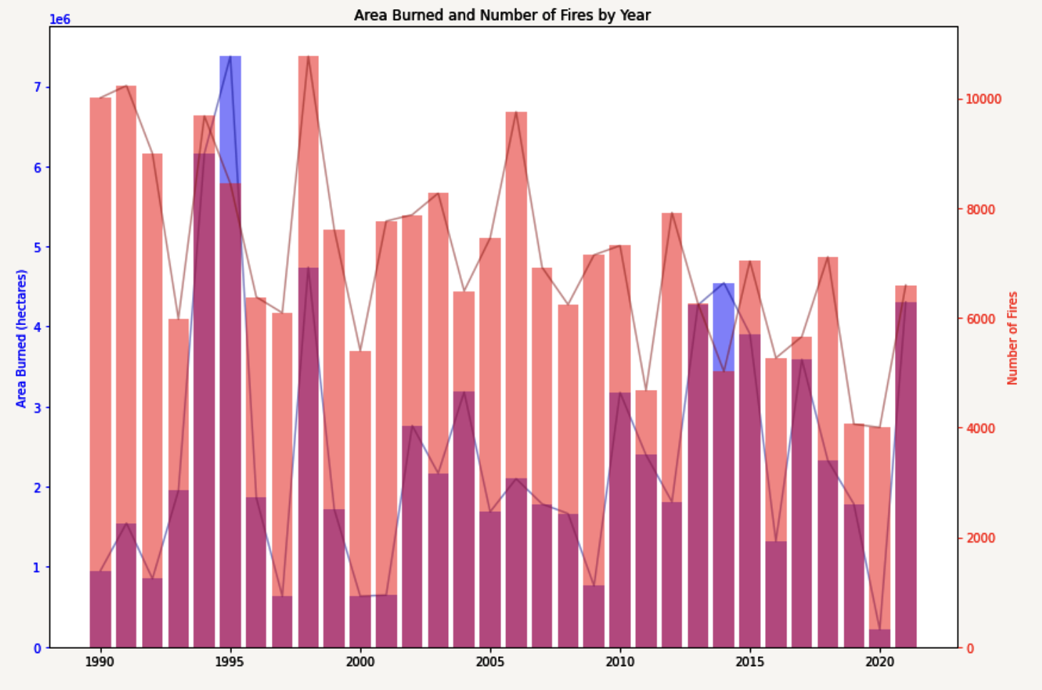
Canada Wild Fire
Even though global warming is causing dryer conditions, we can see that the area burned by fires

Slide 9
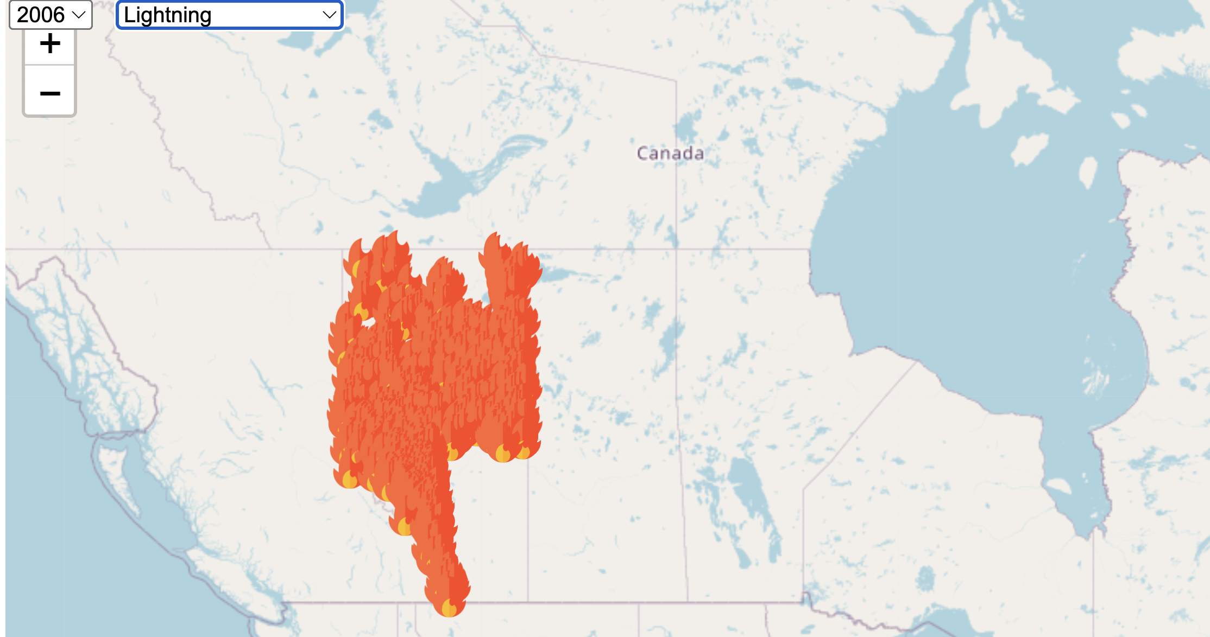
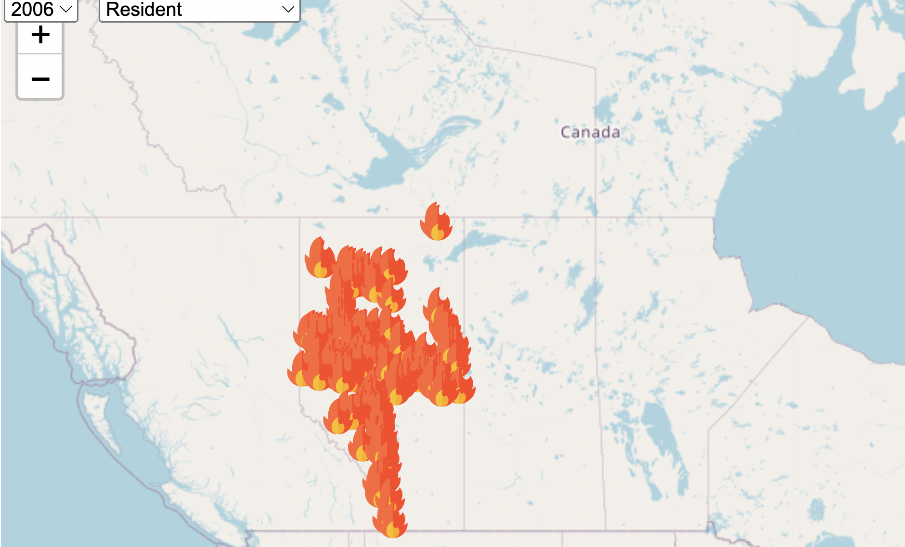
Canada Wild Fire

Slide 10
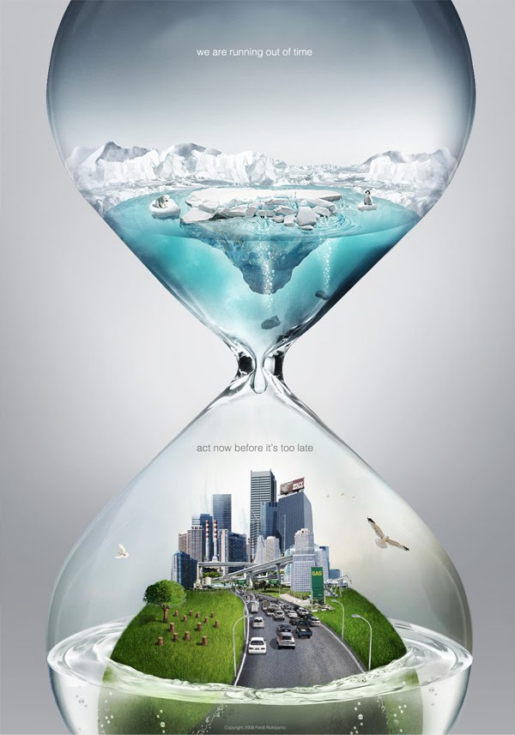
What is next?

Slide 11
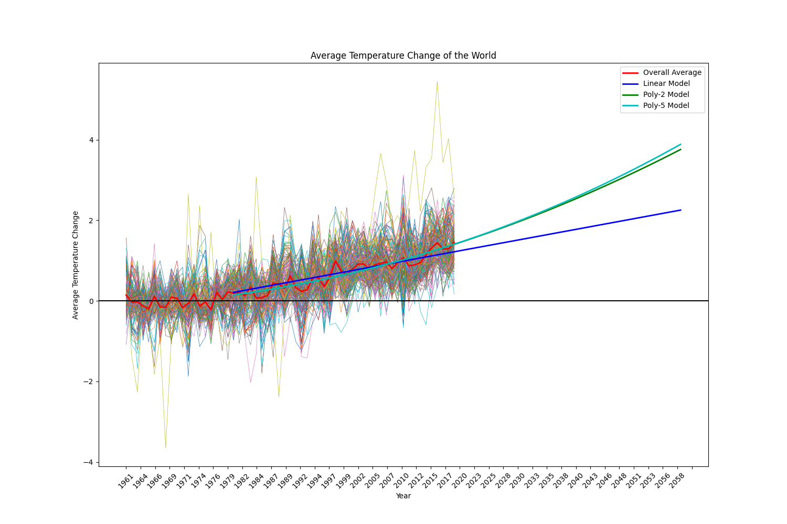
Machine Learning Model on Temp. Change
Our Model predicts rise in temperature in future
Past data 60 years
Predicted data include 40 years

Slide 12


